Slide 1
14. 06. 2026
SUNDAY SERVICE
A.I.C Skyway, Nairobi
Pr. MESHACK MBITHI

Slide 2
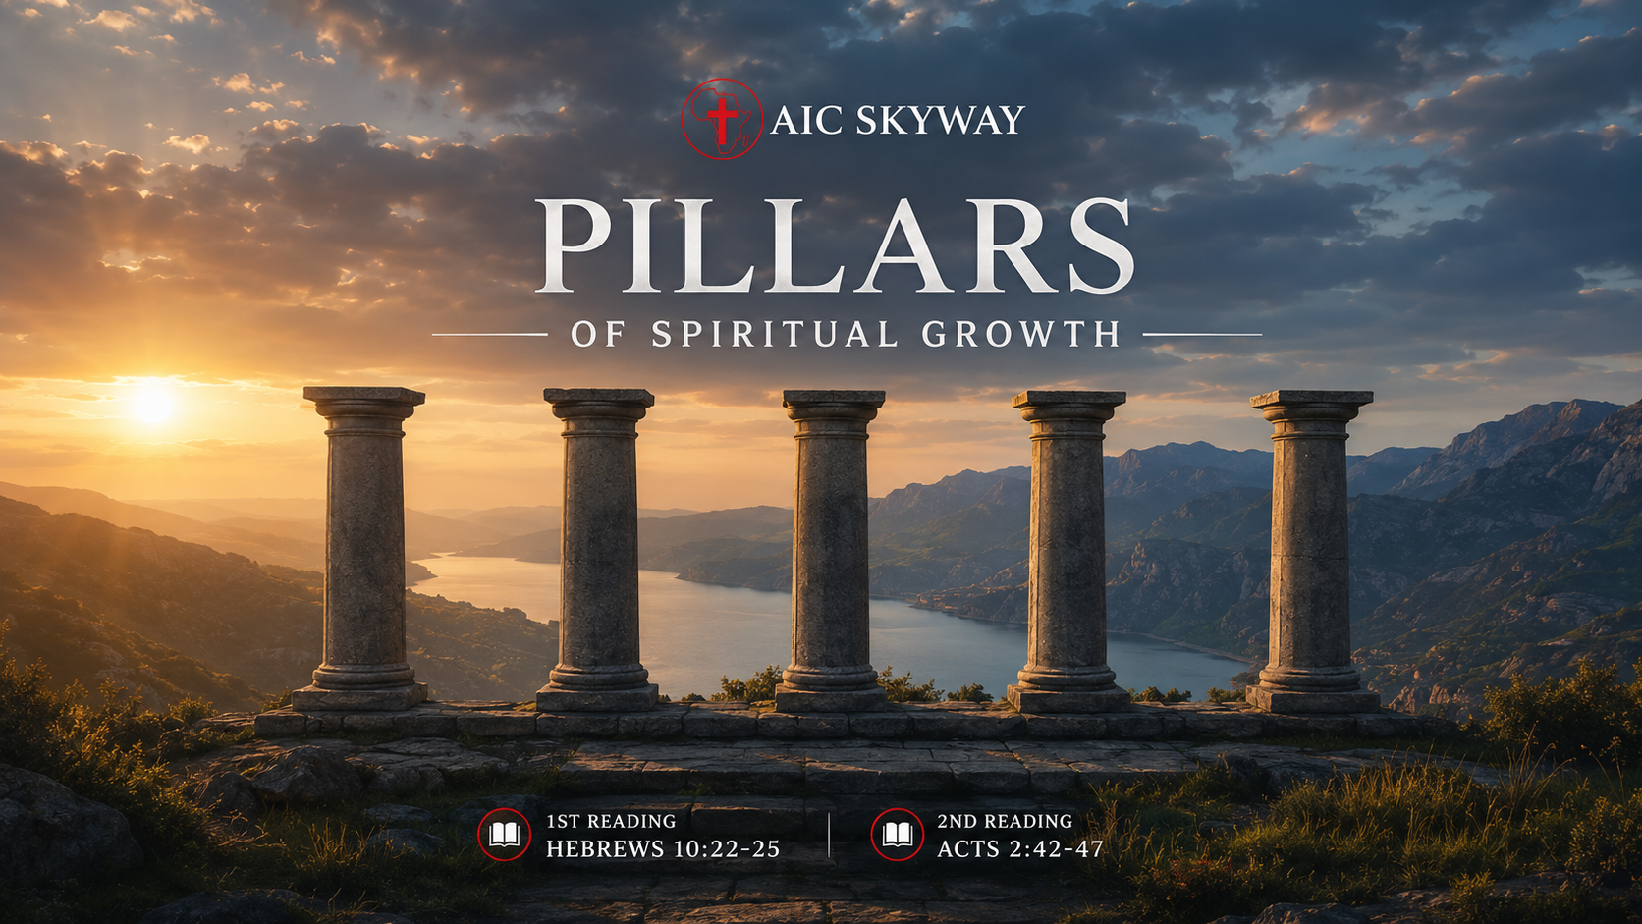

Slide 3
1ST Reading:
Hebrews 10:22-25
2nd Reading:
Acts 2:42-47

Slide 4
INTRODUCTION
Pillars are foundational spiritual practices and principles established by God that support, strengthen, and sustain a believer's growth in Christ.
Just as a building needs strong pillars , a Christian needs biblical foundations to grow strong in faith, character, obedience, and relationship with God.

Slide 5
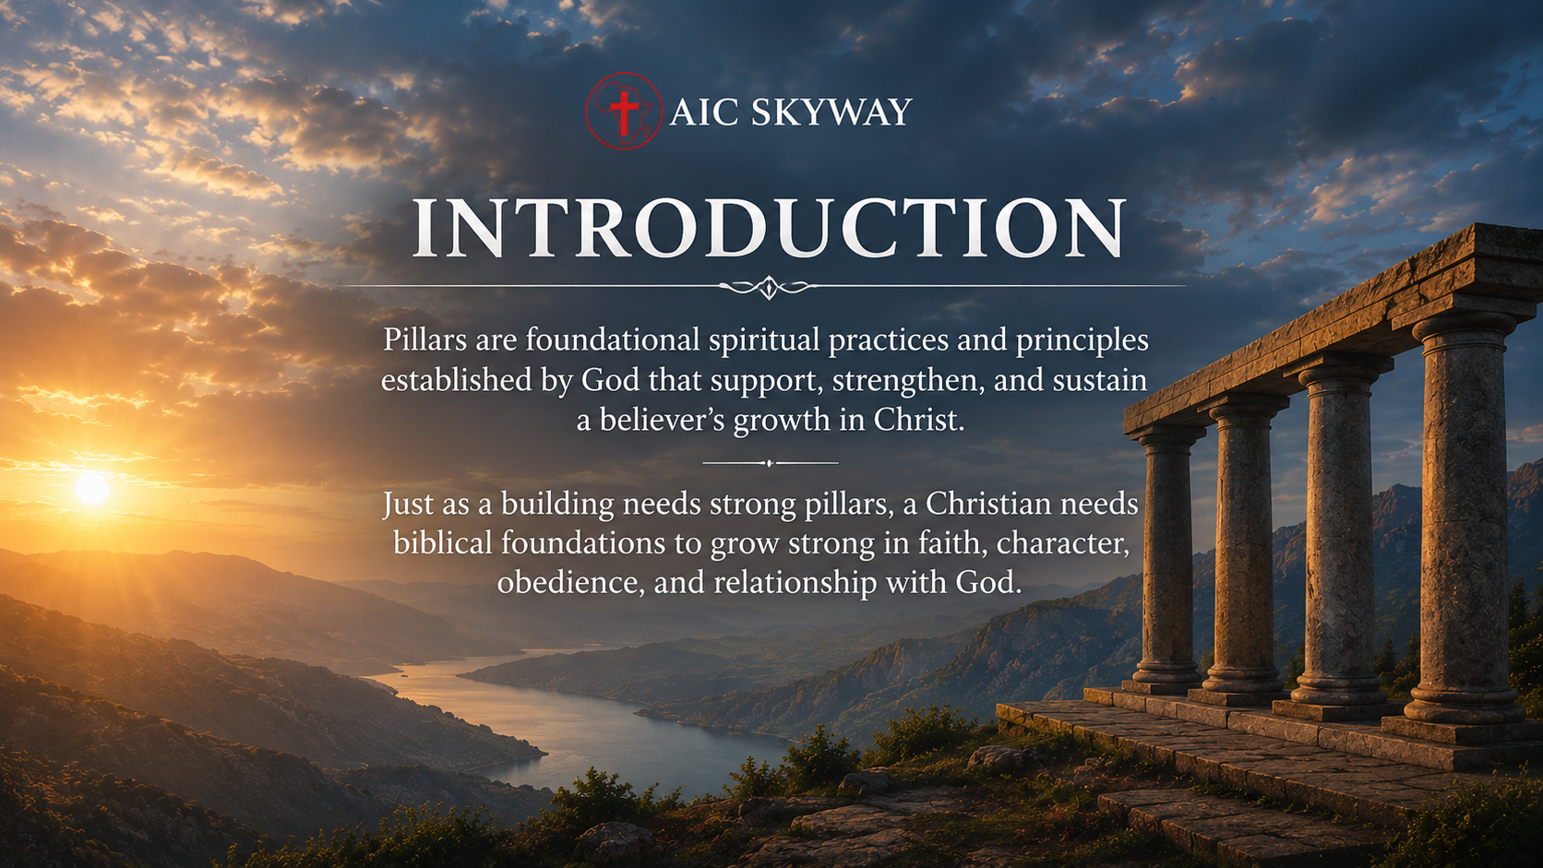

Slide 6
Spiritual growth is the ongoing process by which believers are transformed into the likeness of Christ through the work of the Holy Spirit and their active response to God's Word and will.
Spiritual Growth. 2 Peter 3:18
Becoming Like Christ. Romans 8:29
The Holy Spirit's Work. 2 Corinthians 3:18
Our Participation Is Required. Philippians 2:12–13

Slide 7
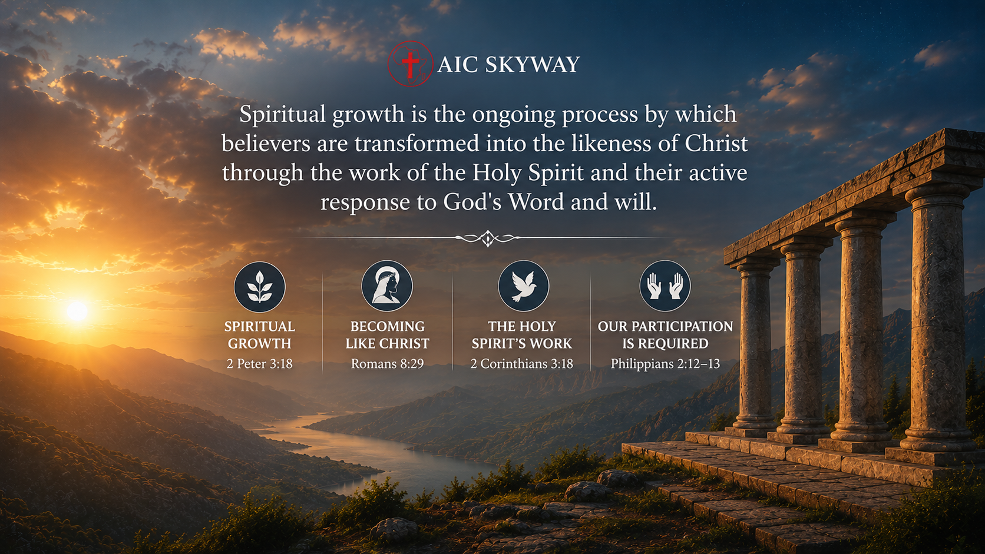

Slide 8
1. The Word of God
Spiritual maturity comes through knowing and obeying Scripture.
Knowing the Word of God:
I. Brings Depth to Your Spiritual Life. Col 3:16, Jos1:8
II. Protects You from Deception. Acts 17:11, Mat 24:24
III. Gives Power Over Temptation. Mat 4:1-11, Ps 119:11
IV. Clarifies the Voice of the Holy Spirit. John 16:13, John 14:26
V. Strengthens Your Ability to Stand Strong in Difficult Seasons. Eph 6:17 , Psalm 1:2-3

Slide 9
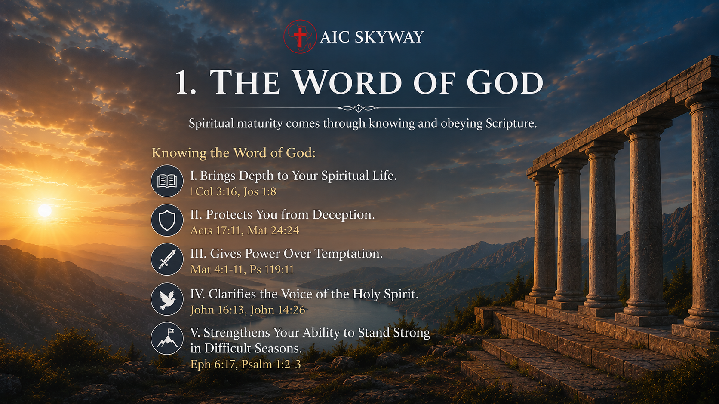

Slide 10
2. Prayer
1 Thess 5:17 , Col4:2
Prayer strengthens our relationship with God.
Through prayer we receive guidance, strength, and peace.

Slide 11
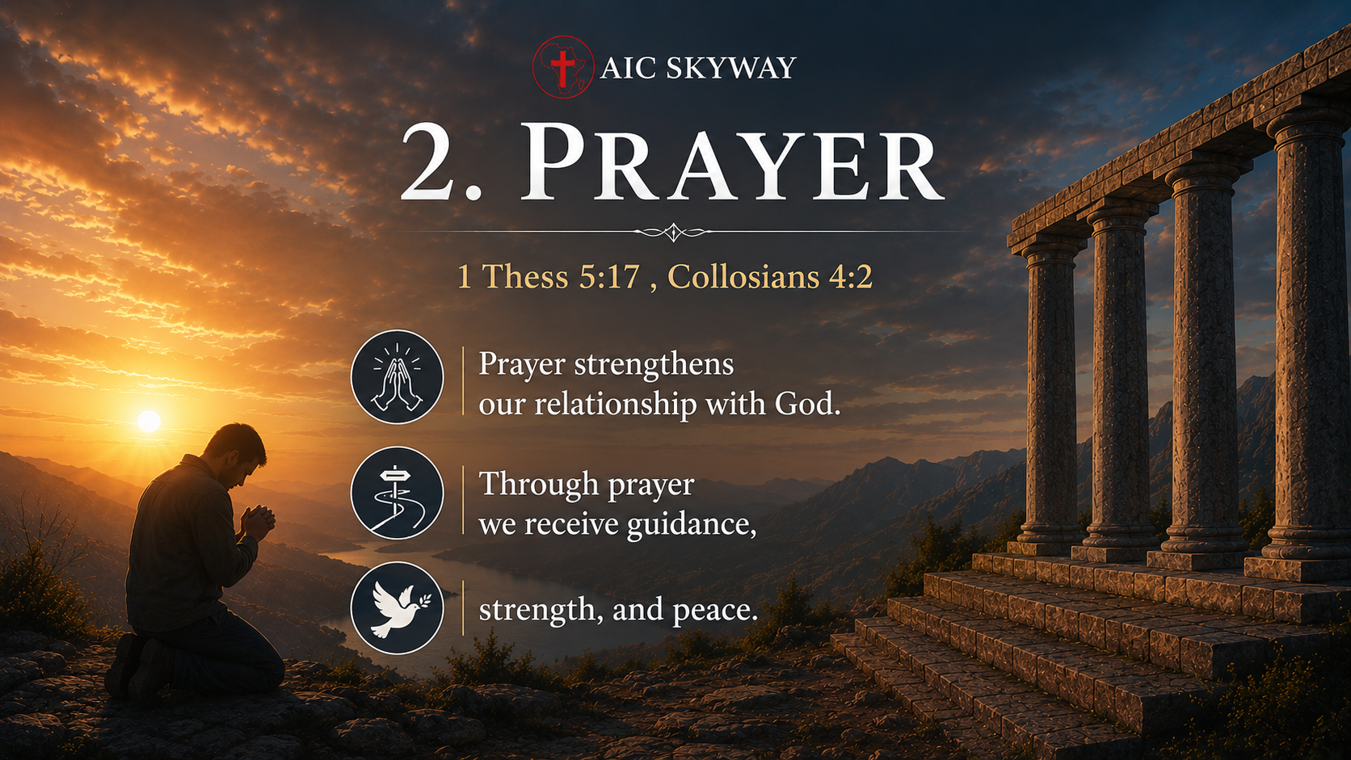

Slide 12
3. Fellowship
Hebrews 10:24–25
God designed believers to grow together.
Fellowship provides: encouragement, accountability, and support.
Isolation often leads to spiritual decline.

Slide 13
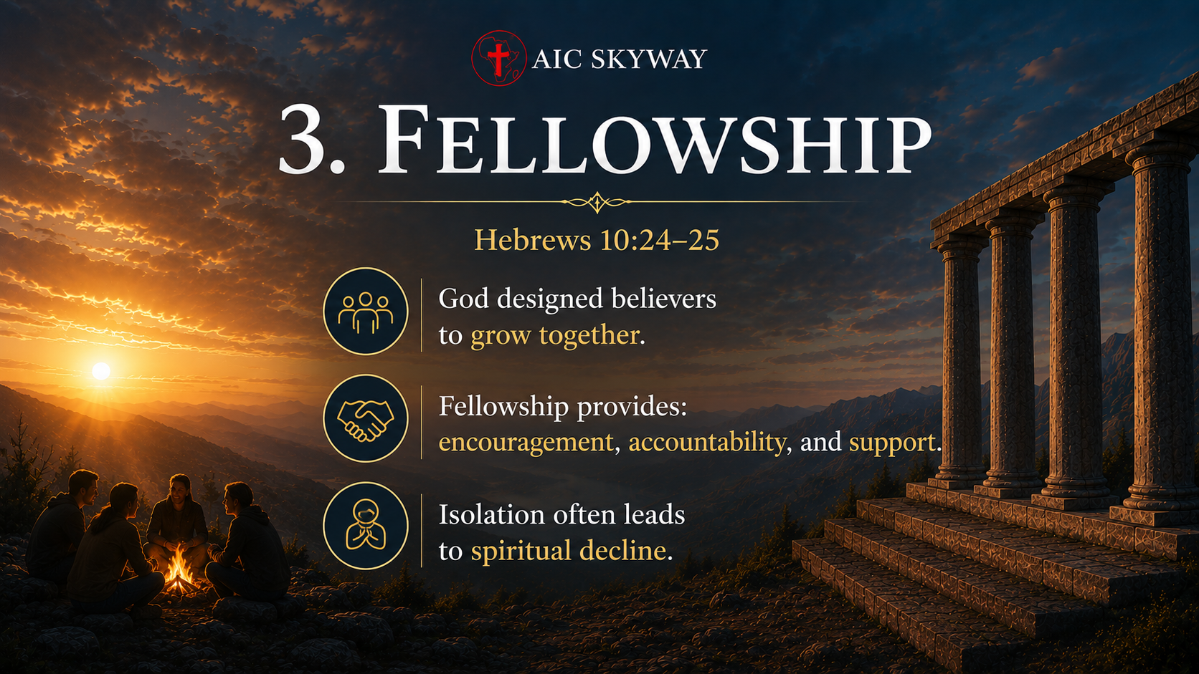

Slide 14
CONCLUSION
A strong Christian life is built on three essential pillars:
God's Word – feeding the soul.
Prayer – connecting with God.
Fellowship – growing together with other believers.
When these pillars are firmly established, believers become spiritually mature, fruitful and steadfast in their walk with Christ.

Slide 15
